Slide 1
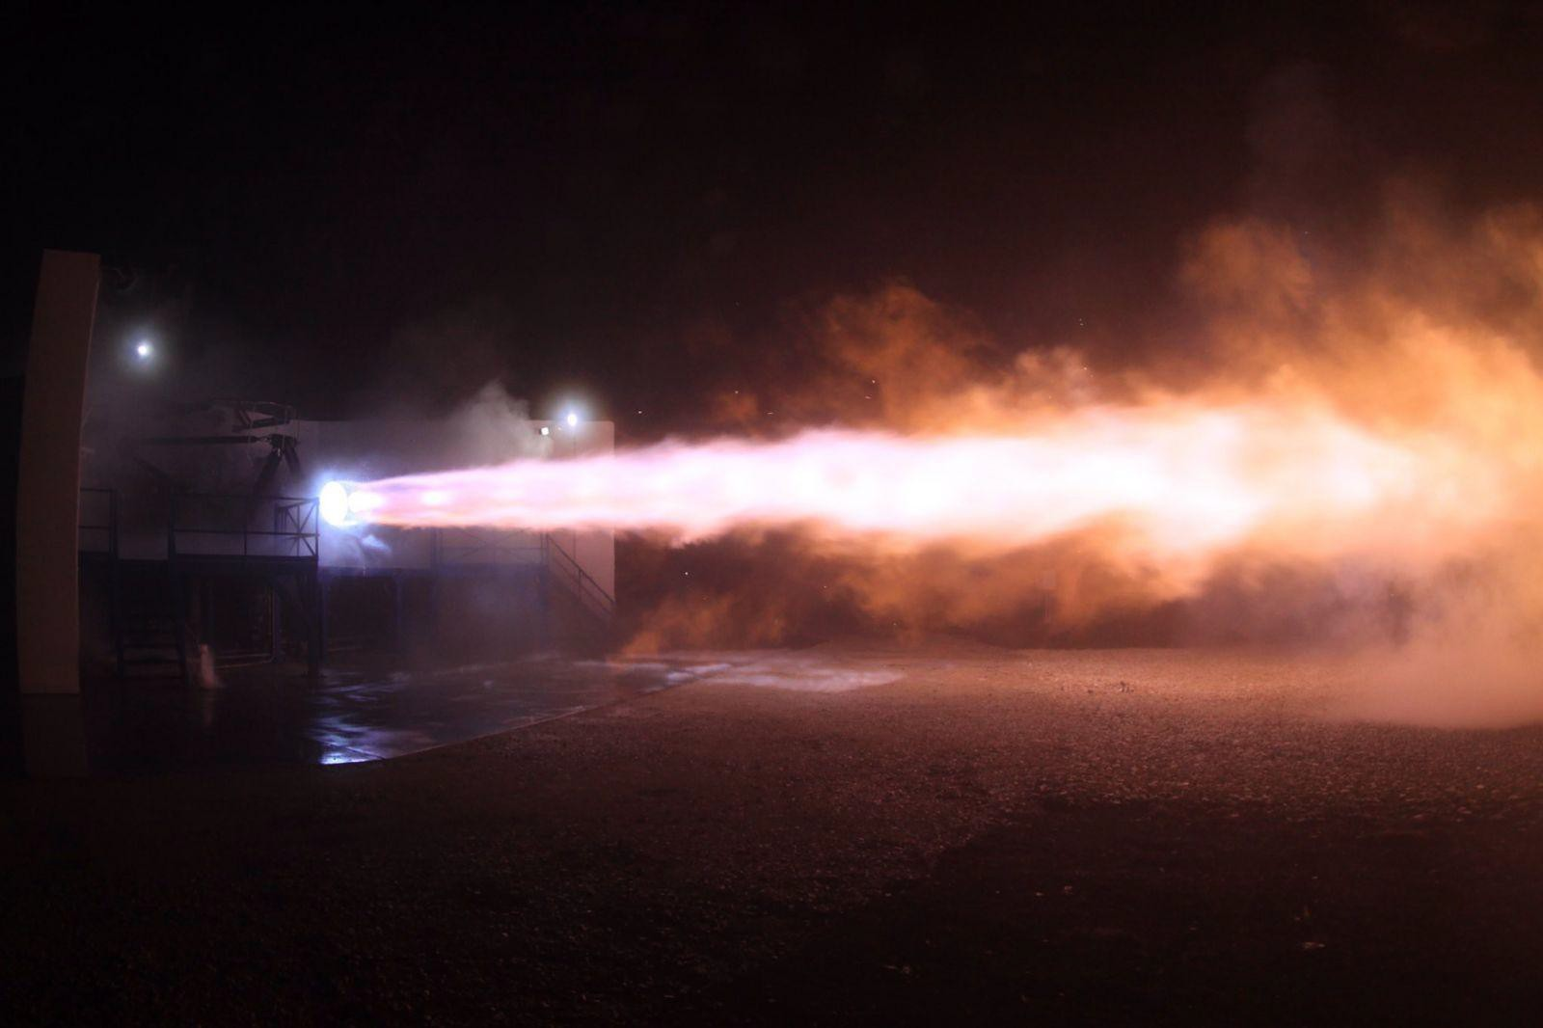



THRUST 2021-2022
Introduction for new prospects
meets
27 Apr 2022 – 8:30

Slide 2
THRUST 2021-2022
Introduction for new prospects
WHAT
Transdisciplinary Hybrid
Rocket University Students’ Training
People that join the project come from diﬀerent backgrounds and disciplines. The project integrates their skills by collaborating towards a shared goal.

Slide 3
THRUST 2021-2022
Introduction for new prospects
WHAT
Transdisciplinary
Hybrid Rocket University Students’ Training
The goal is to build a rocket with hybrid technology, in which the Space Propulsion Laboratory of the University has many years of expertise.

Slide 4
THRUST 2021-2022
Introduction for new prospects
WHAT
Transdisciplinary Hybrid
Rocket University Students’ Training
The project is made by the students for the students of the University of Padua.

Slide 5
THRUST 2021-2022
Introduction for new prospects
WHY
WHO
WHAT
WHEN
WHERE
HOW

Slide 6
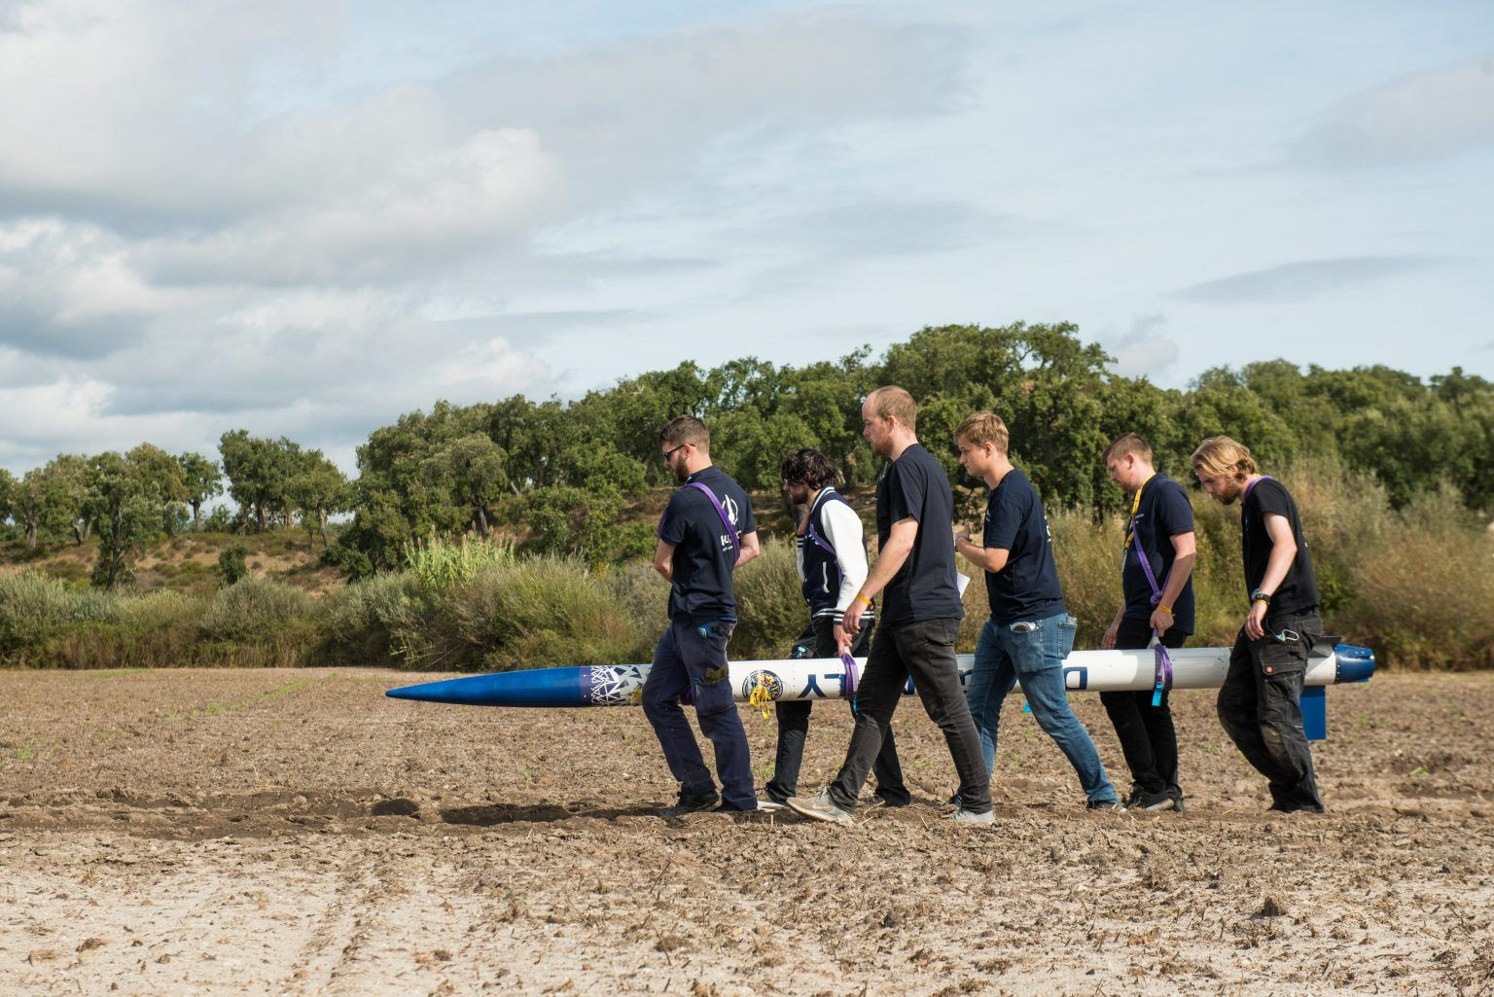
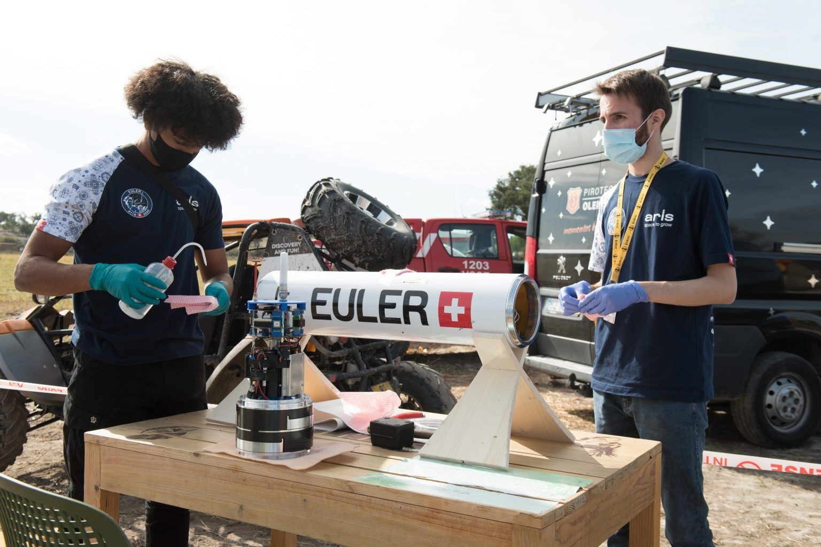
THRUST 2021-2022
Introduction for new prospects
WHAT
EuRoC

Slide 7
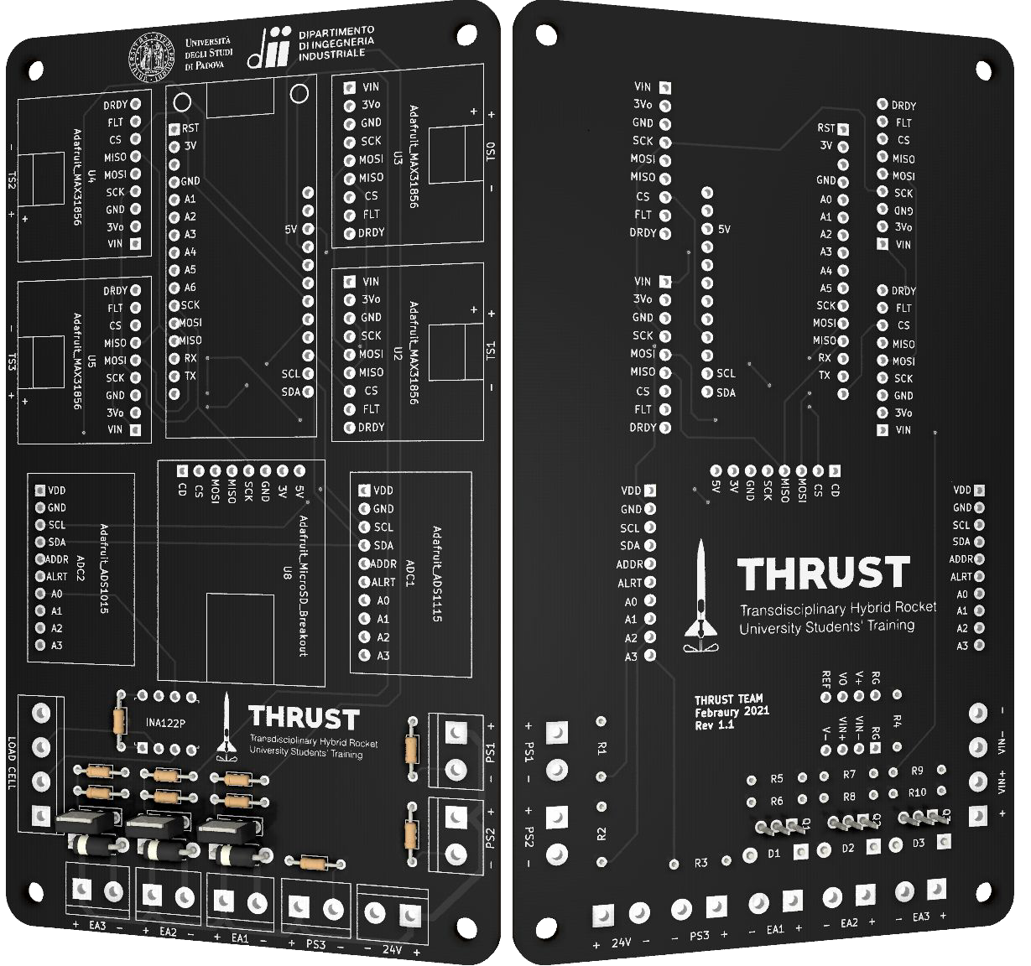
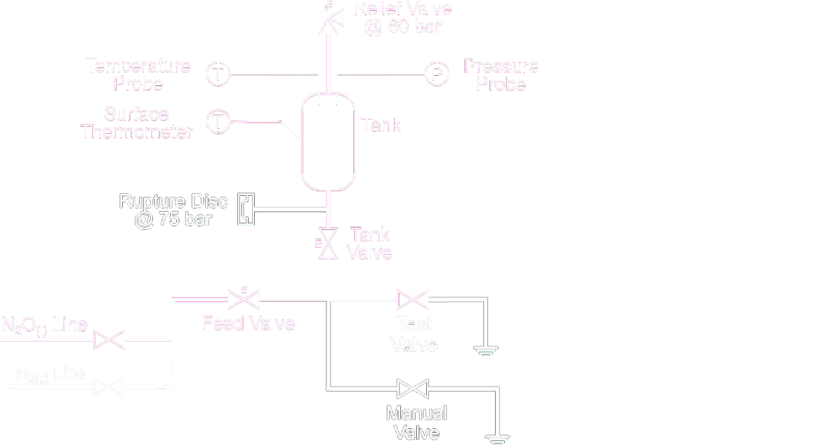
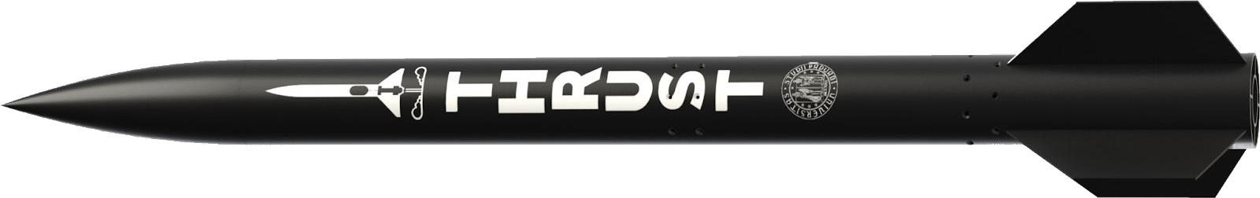
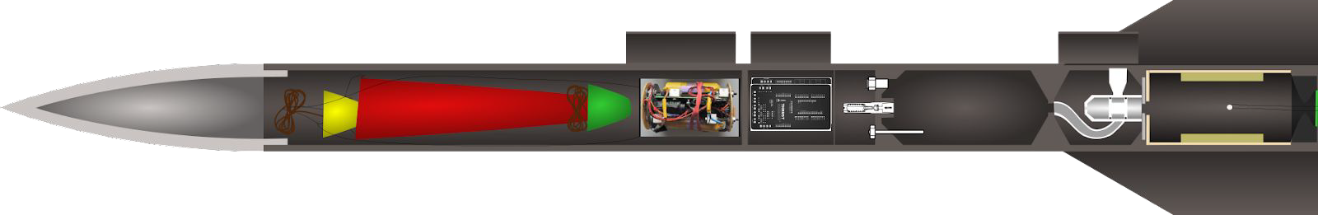
THRUST 2021-2022
Introduction for new prospects
WHAT
SFR : BFR = THRUST : SpaceX

Slide 8
THRUST 2021-2022
Introduction for new prospects
WHAT
Teams
Aerostructure
Electronics
Propulsion
Recovery
Payload
Testing
Management
System
Outreach

Slide 9
THRUST 2021-2022
Introduction for new prospects
WHAT
Main activities
Physical Models and Coding
Design and Manufacture
Mission Analysis
Requirement Management
Prototyping
Documentation
Tradeoff Reports
Risk Management
Presentation
Budgeting
Communication
Sponsoring
Branding
many more
Scheduling

Slide 10
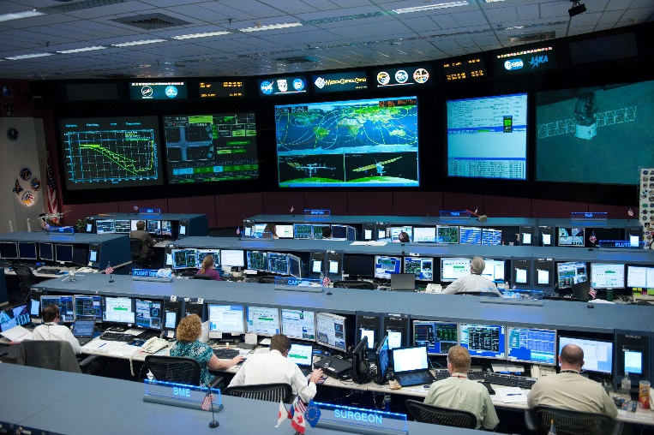
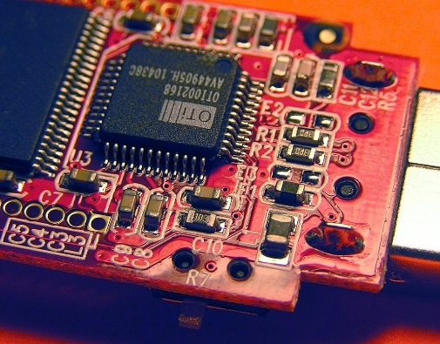
ELECTRONICS What we have to do...
Ground Station
Electronic Board
Firmware

Slide 11
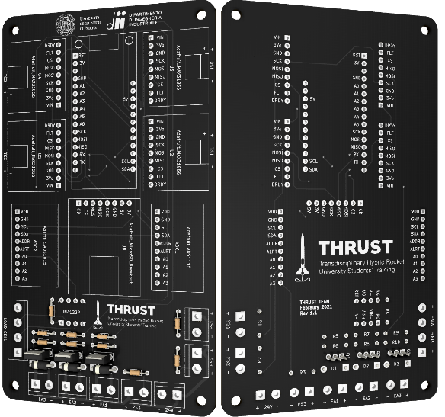
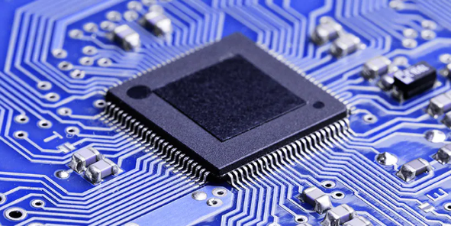
ELECTRONICS We are searching for students that:
Have experience in kicad (or alternative tools for the design of electric board)
Know how to work with microcontrollers (Arduino, Teensy, eps32, smt32, rp2040)
Have basic knowledge in coding
Have basic knowledge in telecomunication or experience with LoRa, MavLink or other protocols (optional)
WANT TO PUT THEMSELVES OUT THERE
WANT TO LEARN BY DOING

Slide 12
THRUST 2022-2023
Introduction for new prospects
WHEN
Project milestones
June
2022
Sep
2022
Oct
2022
Nov-Dec
2022
Testing campaign
Launch campaign (Medicina, BO)
Check of the results
Definition of new milestones

Slide 13
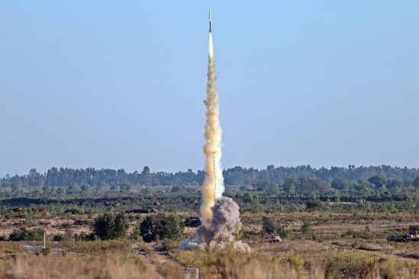

THRUST 2022-2023
Introduction for new prospects
WHEN
Project milestones
Last launch
Campaign in
Aug-Sep 2023
EuRoC
Competition in
Oct 2023

Slide 14
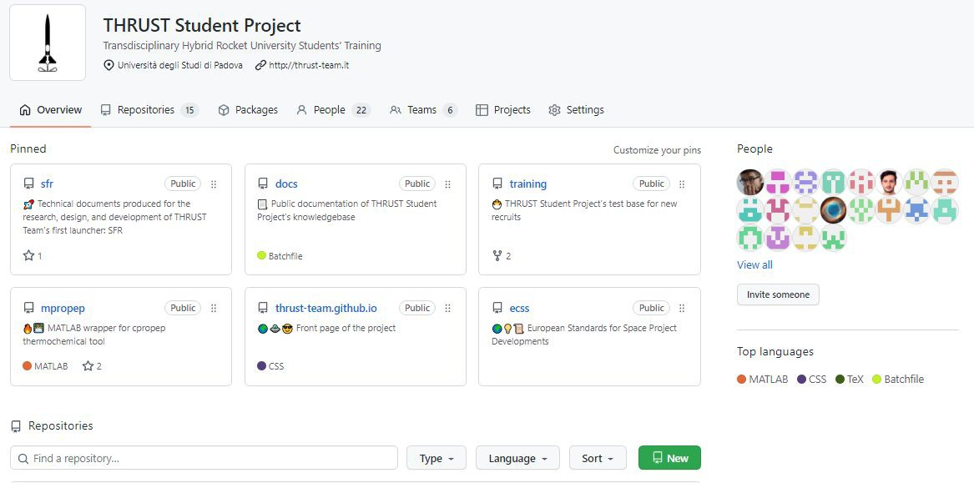
THRUST 2021-2022
Introduction for new prospects
WHERE

Slide 15
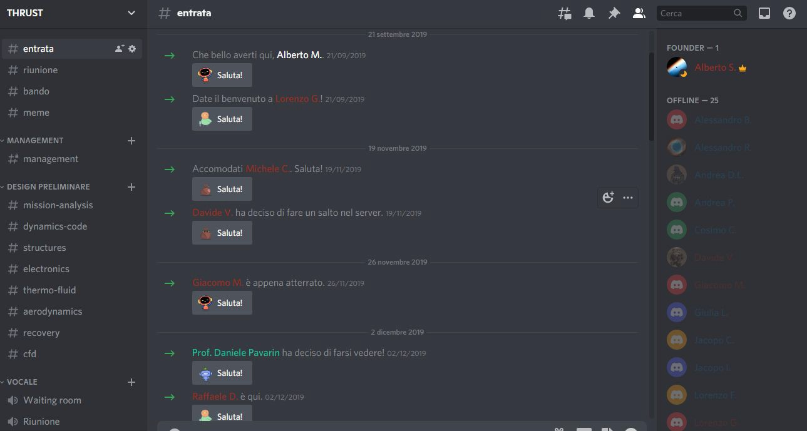
THRUST 2021-2022
Introduction for new prospects
WHERE

Slide 16
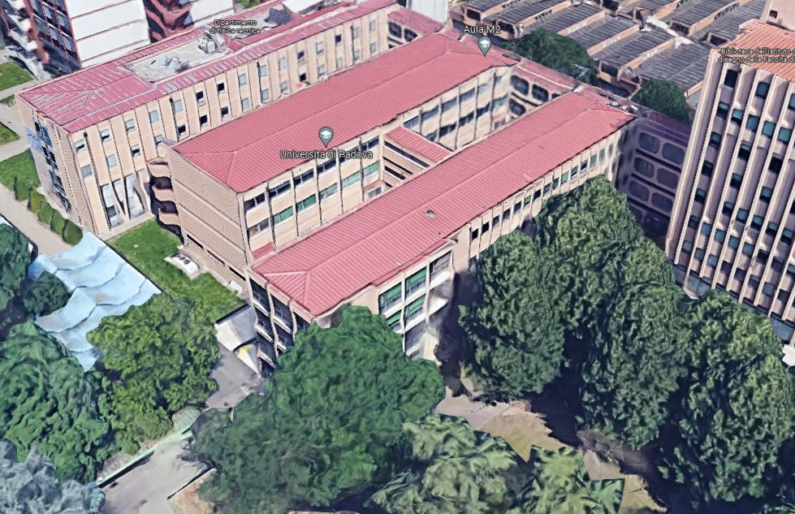
THRUST 2021-2022
Introduction for new prospects
WHERE

Slide 17
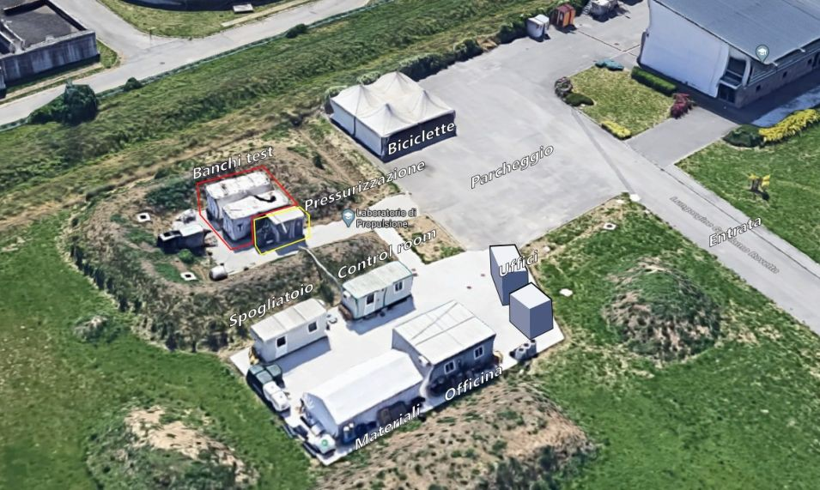
THRUST 2021-2022
Introduction for new prospects
WHERE

Slide 18
THRUST 2021-2022
Introduction for new prospects
WHO
2019-20
Alberto Scomparin Davide Vertuani Alberto Modesti Lorenzo Gerolin Jasmine Giacomelli Giacomo Moresco Michele Cogo Raﬀaele Donazzon Jacopo Irone
2020-21
Alberto Scomparin Lorenzo Gerolin Raﬀaele Donazzon Jacopo Irone Paolo Bertosin Matteo Fiorio Lorenzo Fiorese Massimo Dau Andrea De Lorenzi
2021-22
Jacopo Irone Matteo Fiorio Lorenzo Fiorese Massimo Dau Andrea De Lorenzi Riccardo Casara Andrea Pacilli Mattia Candelato Marco Dalla Torre
Luca Brovedani Alessandro Busato Giulia Lana Alessandro Rampazzo Cosimo Casotto Jacopo Cappozzo Matteo Andriolo Edoardo Romani
Luca Mancini
you…?

Slide 19
THRUST 2021-2022
Introduction for new prospects
WHO
The following will be the most crucial year.
Most of the founders and the ﬁrst leader will not be part of the project, and the number of participants is at record high.

Slide 20
THRUST 2021-2022
Introduction for new prospects
WHO
The requirements for joining the project are simple, but hard:
You must ﬁercely chase the goal and the mission
You must become the project
You must not stop if you don’t know something
If you fail you must try again. Failure is the best teacher.
You must make it so that your colleagues won’t repeat your mistakes
You’ll have to show your work and let it be criticized by your peers
If it scares you, it’s ok. If you’re willing to do it anyway, join us.

Slide 21
THRUST 2021-2022
Introduction for new prospects
WHY
Because why not.
We chose to [...] do [...] things not because they are easy, but because they are hard.
Competition drives progress.
We love space.
It’s not rocket science.
We want to learn by doing.

Slide 22
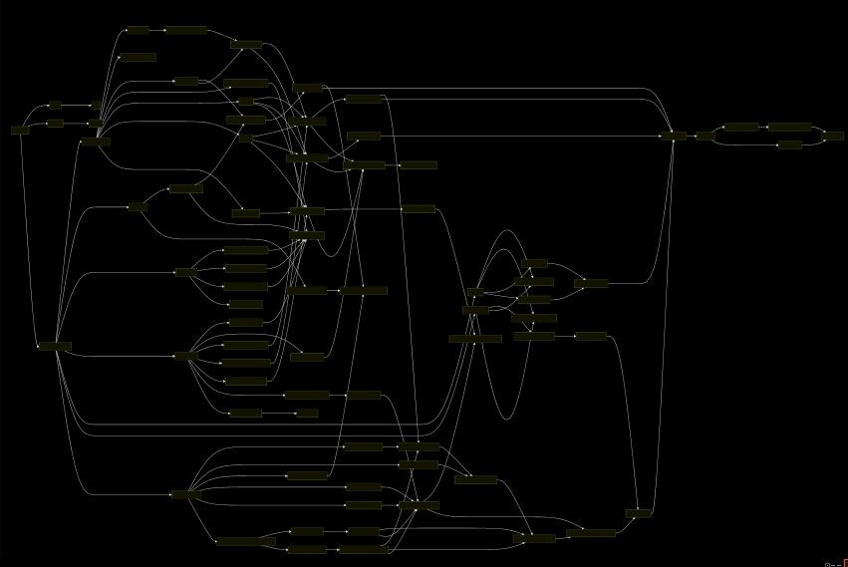
THRUST 2021-2022
Introduction for new prospects
HOW
A structured plan of action allows everyone to see the bigger picture and ﬁnd where they can contribute.

Slide 23
THRUST 2021-2022
Introduction for new prospects
Thank you for your time.
Any questions?

Slide 24


THRUST 2021-2022
CONTACTS
THRUST TEAM thrust.unipd@gmail.com
Riccardo Casara riccardo.casara@studenti.unipd.it
Andrea Pacilli andrea.pacilli@studenti.unipd.it
Matteo Andriolo matteo.andriolo.2@studenti.unipd.it
thrust.team

